Slide 1
How Is Information Security Implemented ?
Three pillars of information security:
People
Process
Technology

Slide 2
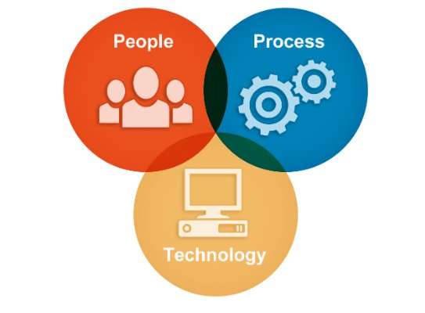
How Is Information Security Implemented ?
REF: LINKEDIN

Slide 3
How Is Information Security Implemented ?
Leadership commitment:
“Tone at the top”
Information security policy and objectives
Assigning responsibility and authority
Resource allocation
Performance reviews
Ensuring accountability

Slide 4
How Is Information Security Implemented ?
Information Security Manager or CISO:
Heads department responsible for implementing information security program
Directs planning, implementation, measurement, review, and continual improvement of program

Slide 5
How Is Information Security Implemented ?
IT user:
Understand policies
Conduct security/risk assessment
Design effective security architecture
Develop SOPs and checklists
Implement controls
Report incidents
Conduct effective change management

Slide 6
How Is Information Security Implemented ?
Business user:
Security awareness and training
Follow information security policy
Develop and implement secure business processes
Role-based access control and periodic reviews
Reporting incidents

Slide 7
How Is Information Security Implemented ?
Information security program
Assessing security risks and gaps
Implementing security controls
Monitoring, measurement, & analysis
Management reviews and internal audit
Accreditation/testing
END

